Slide 1

GAMES RESEARCH & DEVELOPMENT
“This module provides a platform for students to immerse themselves in this rapidly moving stream of innovation, deploying new technologies across a range of contexts and emerging application areas; forming the basis of a valuable portfolio that provides an entry point not only to research and development within the Games industry itself, but also to cutting-edge academic research and real-world application.”
World One Powerful Presentation Template
Notes:
Background placeholder: After choosing your image, Right click on the image -> Send to back -> Click on send to back

Slide 3


Slide 4
THIS
SESSION
Videos
One on One Meetings
Next Week

Slide 5
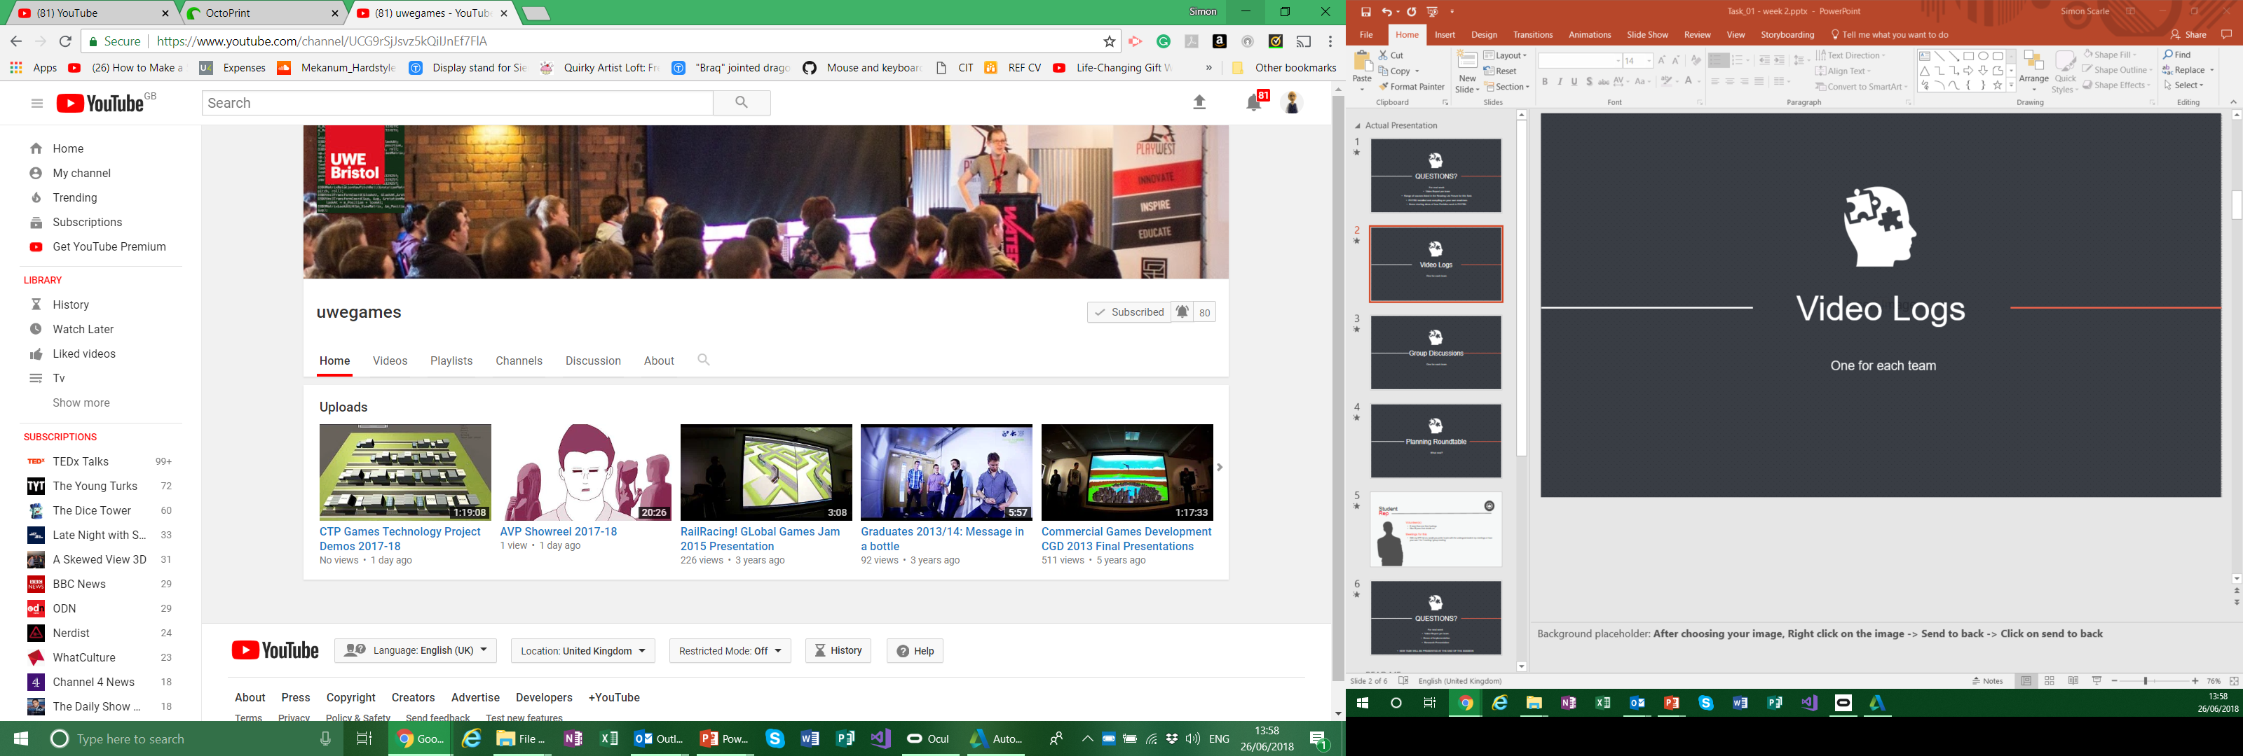
Video Logs
Place your screenshot here
One for each Person.
Unlisted YouTube video.
I’ll add them to this years play list later!
If you think you made something pretty enough
+ TWEET + @UWEGamesMSc

Slide 6

Planning Meeting
One for each person
What has each person done
What next
Documented using OneNote
Forms part of the assignment

Slide 7

Next Week:
Present your first thoughts of what you are going to do and how test it
Basically present your first draft of your wider proposal
Video + Group Discussion
One-on-One documented on OneNote
World One Powerful Presentation Template
Notes:
Background placeholder: After choosing your image, Right click on the image -> Send to back -> Click on send to back

Slide 8
Longer Proposal
The same as the first stage proposal not marked in itself but will form part of your development documentation etc.
You’ll find a consultancy template on Blackboard for a few weeks ago.
Don’t actually use this document, but possibly use similar sections and complete in a similar spirit.
World One Powerful Presentation Template
Notes:
Background placeholder: After choosing your image, Right click on the image -> Send to back -> Click on send to back

Slide 9
Any questions?

